Slide 1
History of
American Stained Glass

Slide 2
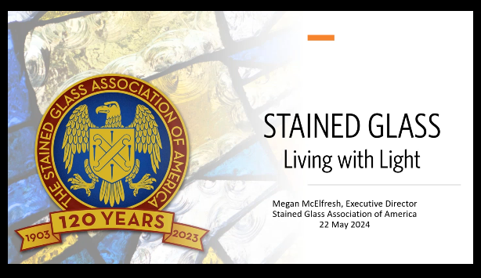
Thanks for photos from recent seminar

Slide 3
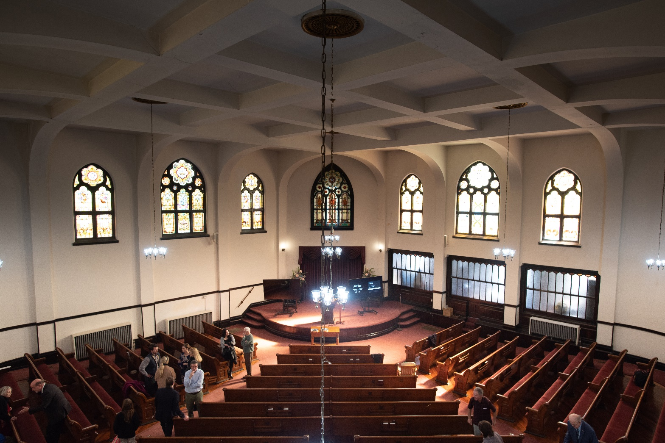
Lindsley Avenue Church was built as a Cumberland Presbyterian Church in 1894—at the height of American Stained Glass Renaissance.

Slide 4
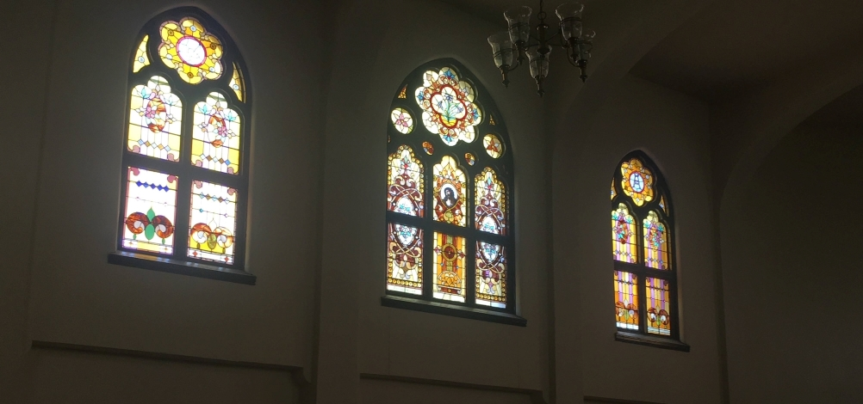
Windows were an afterthought to architecture and were considered a building material in early 1800s.

Slide 5
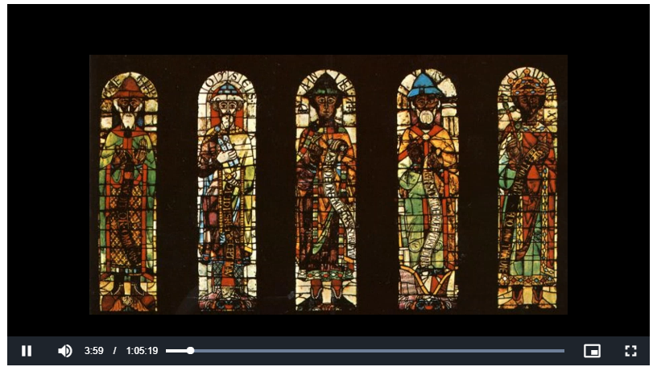
First American Stained Glass, 1843, New York

Slide 6
Early American history
Demand begins to increase for stained glass
Foreign firms coming to American to meet demand
1893, one year before Lindsley Avenue building, the Stained Glass Association of America was created to ask Congress for protection
Took 10 years to get Congressional tariffs (1893-1903)
The 45 American firms created their own patterns, designs, pricing and a new technique

Slide 7
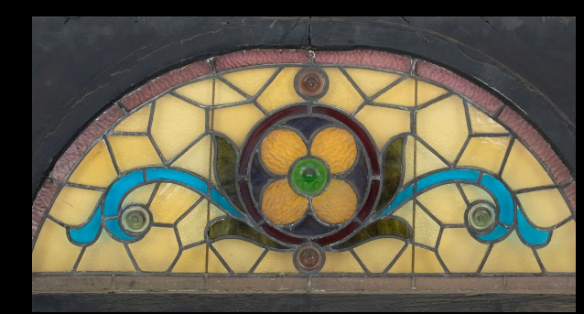
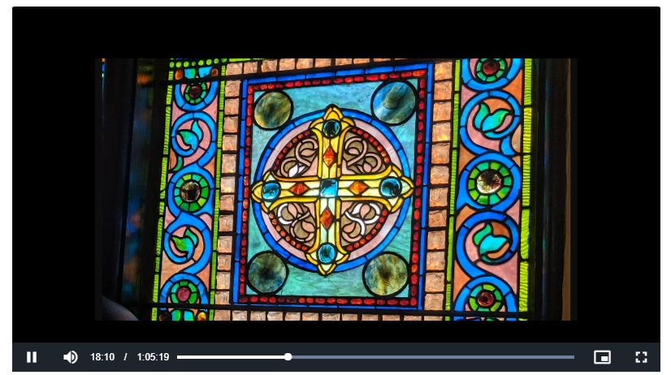
Tiffany: “Mosaics are the parents of stained glass”
Process created to put the paint into the glass to create illuminated glass mosaics

Slide 8
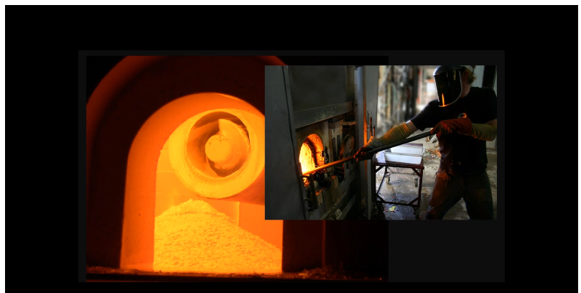
Rollers added to give texture, ripples, folds in glass
Added jewels and ornamentation
Can best be seen by standing under the glass and looking straight up

Slide 9
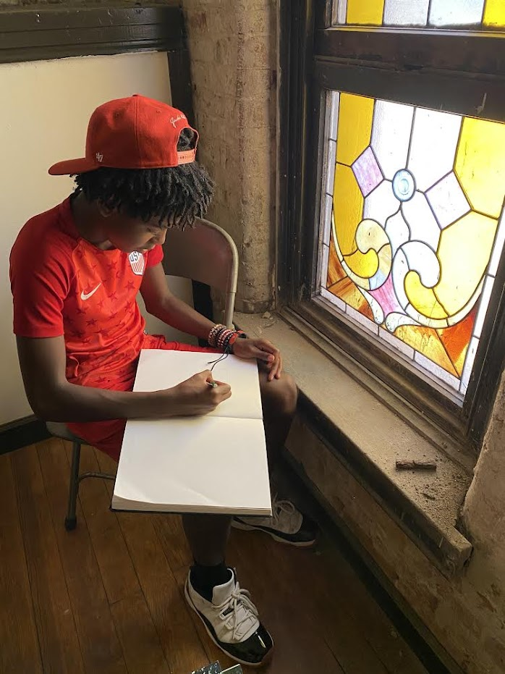
Reinvigoration by artists with the new techniques
Demand increased in early 1900s
Most artists are unknown

Slide 10
Why Save Stained Glass Windows?
Every person who has come in contact with these windows is part of the story of our community and the history of Nashville
We can feel the artisans hand as the makers of the windows—design, creation, hand crafting
Done correctly we view the window as a complete painting that looks effortless

Slide 11
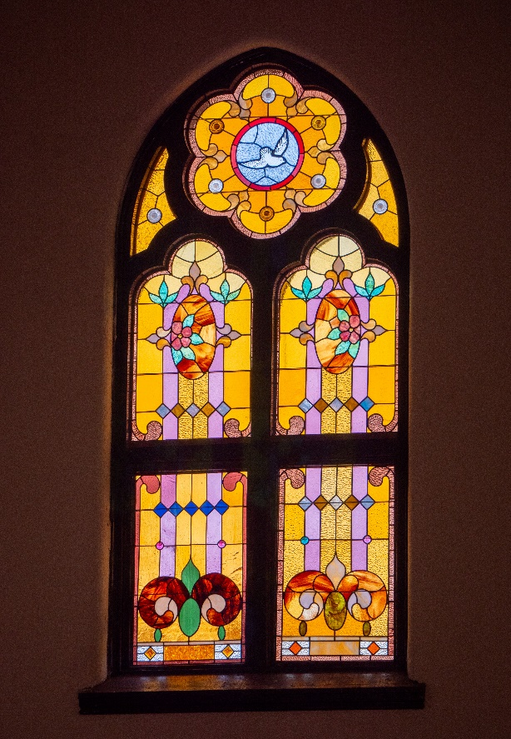
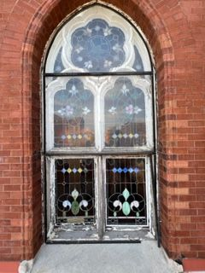
Completed Restoration
Before
After

Slide 12
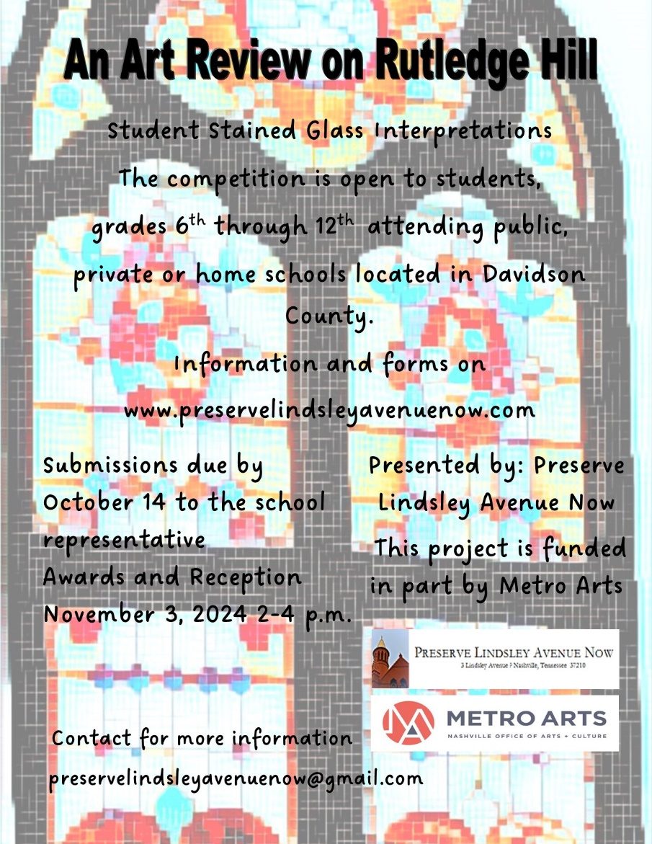
Contact:
preservelindsleyavenuenow@gmail.com
Website
Preservelindsleyavenuenow.com

